Slide 1

Capstone project
Cheryl berger • Lucien Roberts • martha richardson

Slide 2


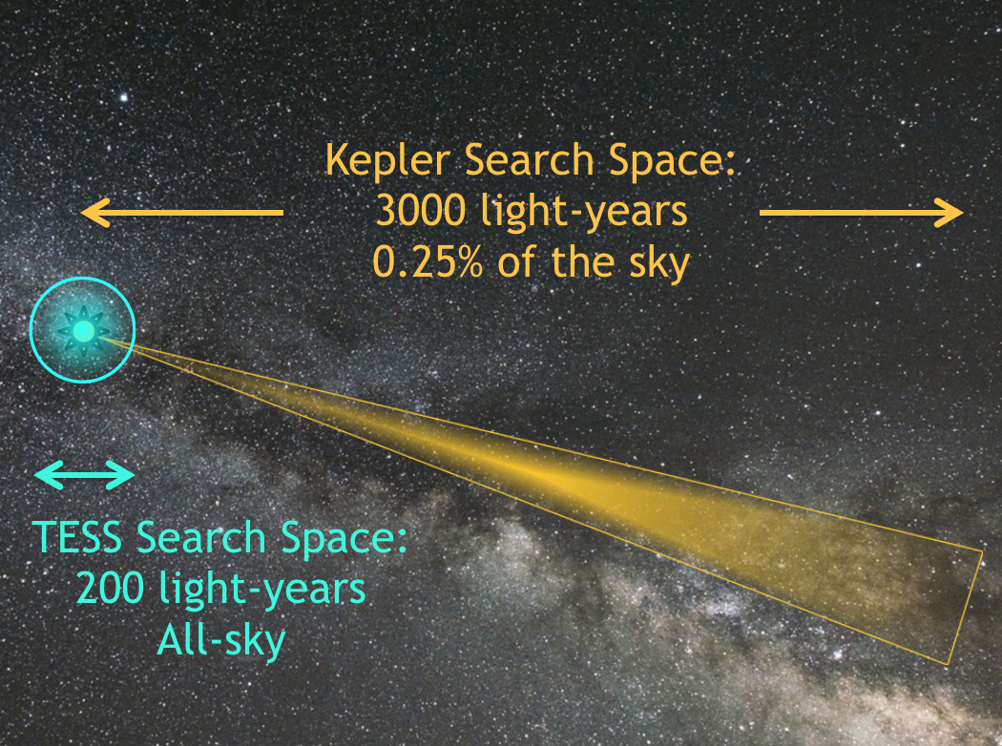


What we considered
Some datasets were too small
Some datasets were too big
We found one that was just right!

Slide 3

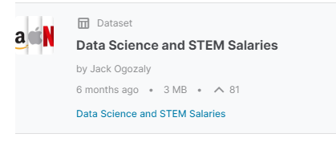
What did we choose?
Kaggle Data Science and STEM Salaries Dataset

Slide 4
Why choose this dataset?
It is extremely relevant to all of us
The dataset pretty large, needs some pre-processing, but is not so big that we have trouble storing and sharing it
There are several columns in the data we can target for different types of machine learning analysis

Slide 5
Description of dataset
62,642 rows
29 columns
Includes company name , job title, salary, bonus, stock option, gender, and race

Slide 6
What are we going to do with all this data?
Clean and pre-process the data
Test linear regression machine learning models to predict salaries given some input features by the user
Discover what features and model make the best predictions
Look for trends in current data science salaries: by location, job title, gender, race, and educational level
Present our results via an interactive table similar to the UFO or Bellybutton projects

Slide 7
Data exploration steps
We intend to clean/process the data columns in the following ways. More details are available in the README.md file on GitHub
Keep as is: yearsofexperience, yearsatcompany, rowNumber
Numeric fields to investigate and maybe keep: totalyearlycompensation, basesalary, stockgrantvalue, bonus.
Categorical fields to keep and possibly bucket: company, title, location
Boolean fields to keep (possibly as is, maybe collapse and use encoding instead): Masters_Degree, Bachelors_Degree, Doctorate_Degree, Highschool, Some_College, Race_Asian, Race_White, Race_Two_Or_More, Race_Black, Race_Hispanic
Fields to drop: timestamp, level, tag, otherdetails, cityid, Race, Education
Fields to keep and mull over missing/mysterious values: gender, dmaid

Slide 8
Database
We created the schema and imported the original datafile into PostgreSQL with the following alterations:
We removed the other details column from the dataset to import into the database. It contained mostly ancillary and unrelated data, making it completely useless for our machine learning project
the headers for the timestamp, level, and location needed to be changed as they were reserved names in PostGres. The rowNumber value was used as the primary key

Slide 9
Proposed machine learning model
We plan to deploy a machine learning model that can be used to predict salaries for data scientists and STEM professionals.
Linear regression is the best model to choose with a continuous variable like salary.
With our cleaned and pre-processed data, we will divide the data into training and testing sets and then train and test our model
The salary prediction by years of service example in Module 17.2.3 is a great place to start for our coding
We will explore which features are the best predictors, and possibly look into other Scikit linear regression models

